Slide 1
The Effectiveness of Randomness Test Suites for Block Ciphers
Luke Y. Tao
Massanutten Regional Governor’s School
Research
Ms. Klus
April 16, 2021

Slide 2
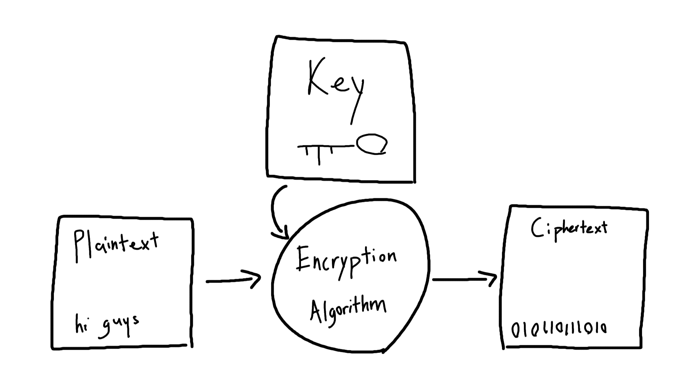
Encryption
Figure 1 Encryption Diagram
In the modern age, everything from banking to taking a class can be done online.
Therefore, it is important to protect the privacy and personal information of users.

Slide 3
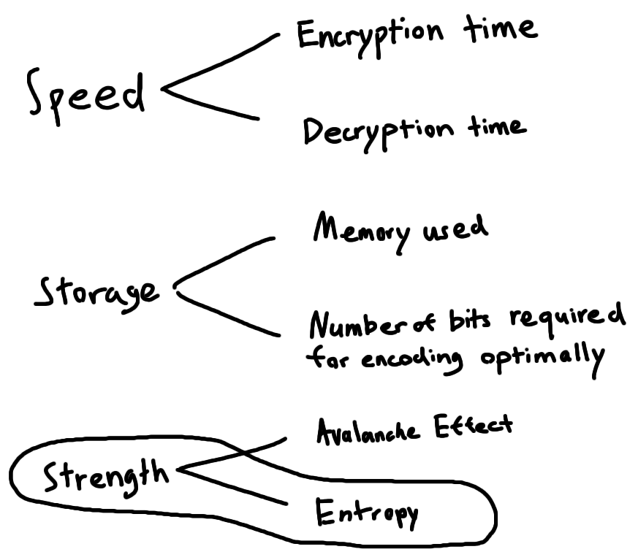
Figure 2 Important Properties of Encryption Algorithms
Note. Information from (Patil et al., 2016)

Slide 4
Measuring Entropy
Randomness has properties and expected behavior
In order to test randomness, a series of tests are used for each property
The results are compared to the expected values and a p-value is calculated
(Gevorkyan et al., 2020)
Test Suites
National Institute of Standards and Technology (NIST) Statistical Test Suite
Dieharder
CryptoStat

Slide 5
Which test suite is best suited for testing the randomness of block ciphers?
Research
Question

Slide 6
Test Suites

Slide 7
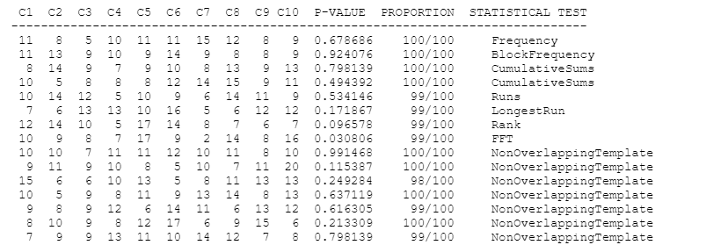
NIST Statistical Test Suite
Figure 3 Example NIST Test Results
created 1997-2000 for a competition to replace the deprecated Data Encryption Standard (DES) with a new Advanced Encryption Standard (AES) (National Institute of Standards and Technology, 2016)
2 layers of p-values (Rukhin, 2011)

Slide 8
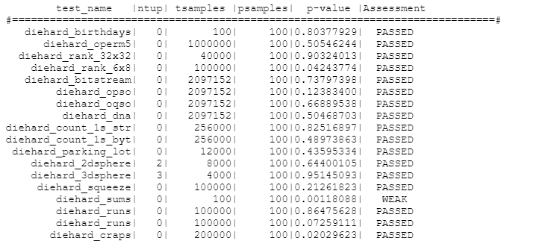
Dieharder
Figure 4 Example Dieharder Test Results
similar to NIST
variable number of samples
2 layers of p-values
tests from: Diehard, NIST, new ones
intended for PRNGs
not intended for file input
(Brown, 2021)

Slide 9
Problems

Slide 10
Multiple Scores
Outputs many statistics based on short subsequences instead of a single summary statistic from one long sequence (Rukhin, 2011)
Makes it difficult to compare results
Different tests have different levels of importance, reliability, and accuracy (Rukhin, 2010)

Slide 11
Modes of Operation

Slide 12
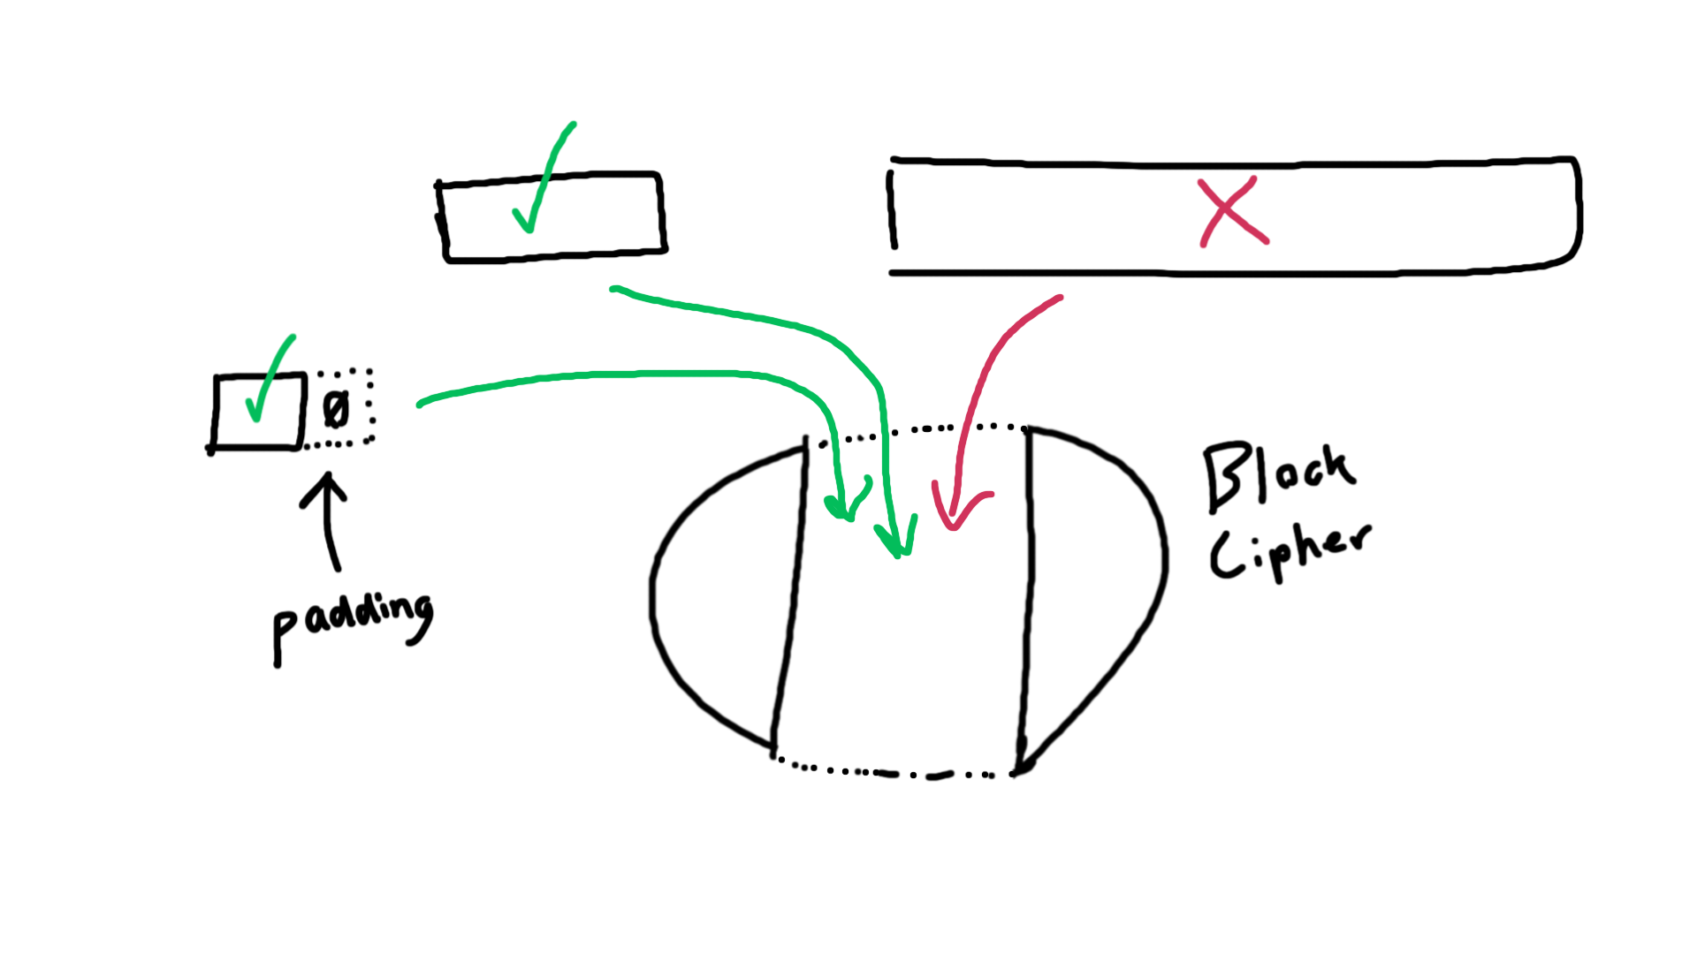
Figure 5 Block Ciphers

Slide 13
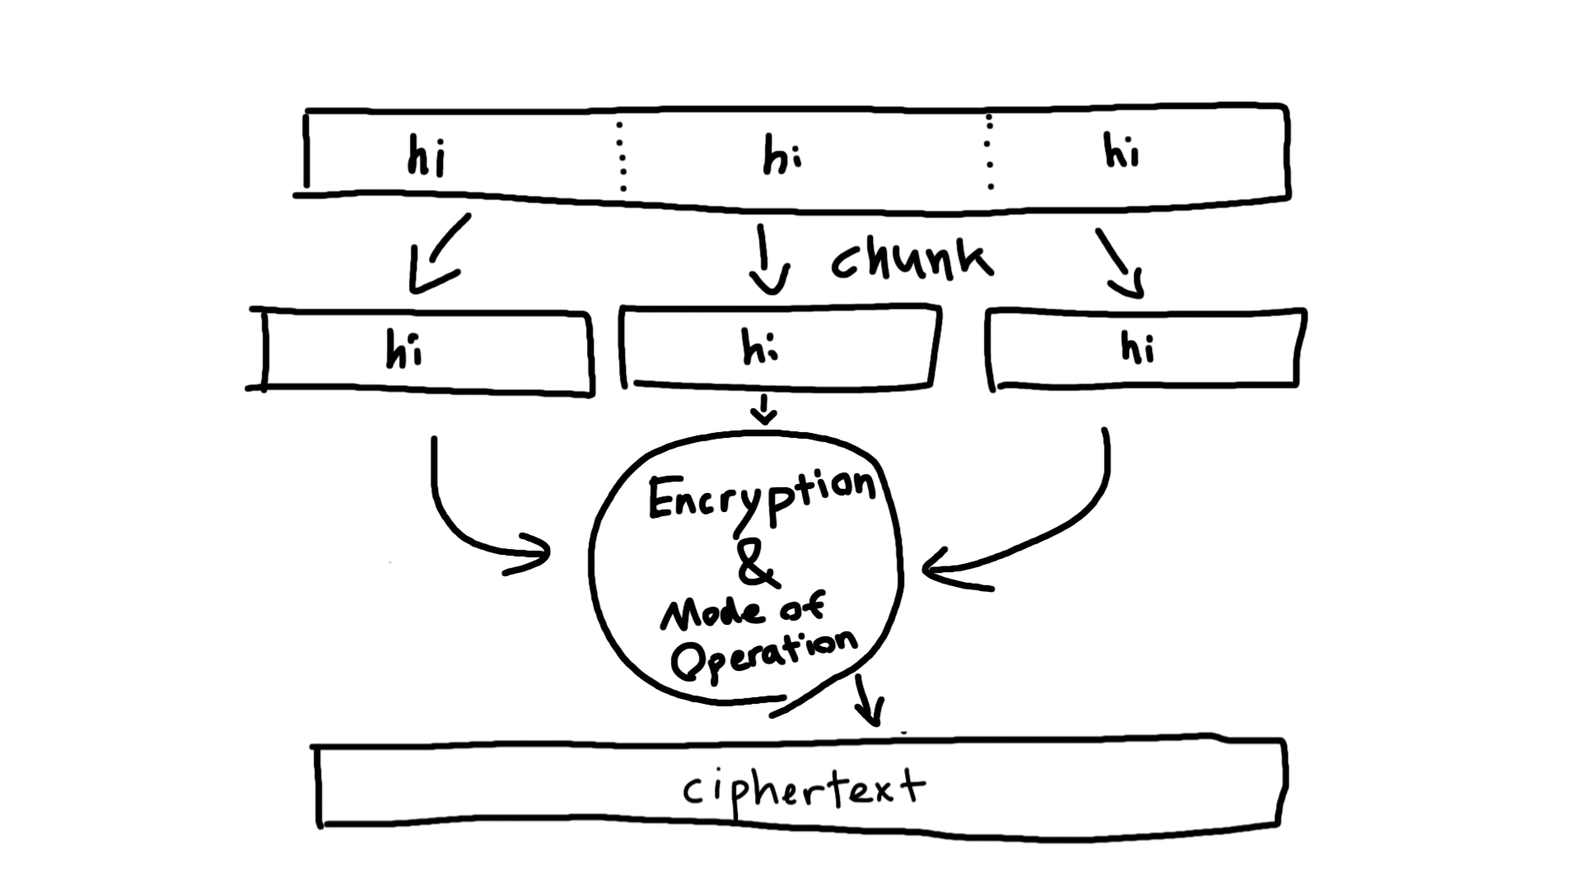
Figure 6 Modes of Operation

Slide 14
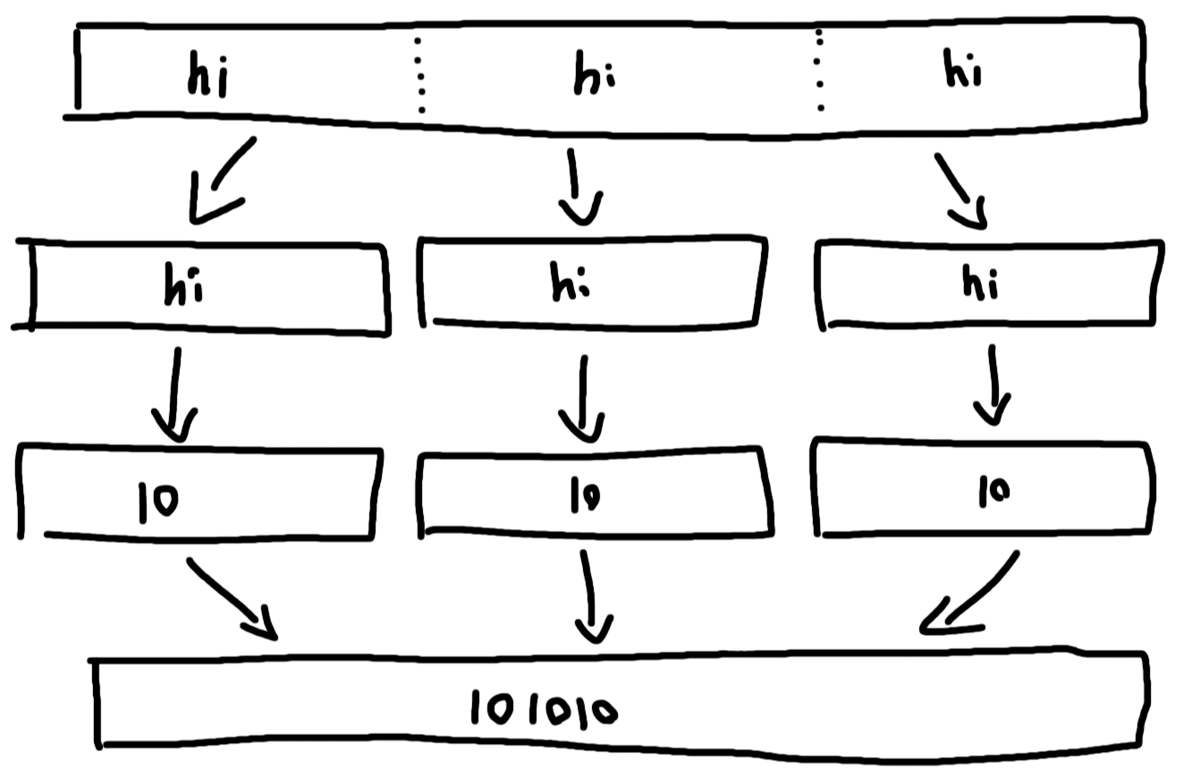
Figure 7 Electronic Codebook (ECB)

Slide 15
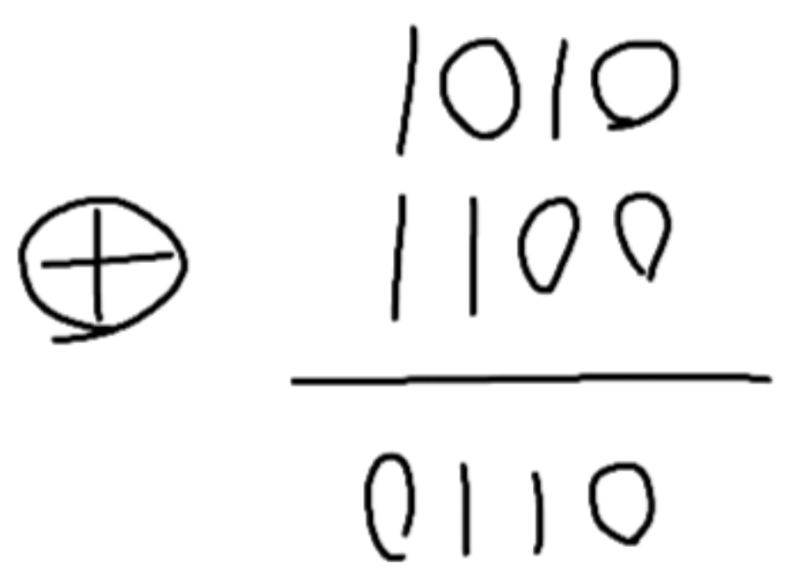
Exclusive-or (XOR)
Figure 9 Exclusive-or
Not a mode of operation
True if parameters are different
Easily reversible

Slide 16
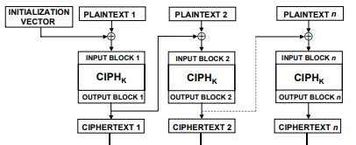
Figure 10 Cipher Block Chaining (CBC)
Dworkin, M. (2001). Recommendation for Block Cipher Modes of Operation: Methods and Techniques. United States Department of Commerce, National Institute of Standards and Technology. https://nvlpubs.nist.gov/nistpubs/Legacy/SP/nistspecialpublication800-38a.pdf

Slide 17
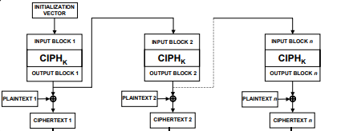
Figure 11 Output Feedback (OFB)
Dworkin, M. (2001). Recommendation for Block Cipher Modes of Operation: Methods and Techniques. United States Department of Commerce, National Institute of Standards and Technology. https://nvlpubs.nist.gov/nistpubs/Legacy/SP/nistspecialpublication800-38a.pdf

Slide 18
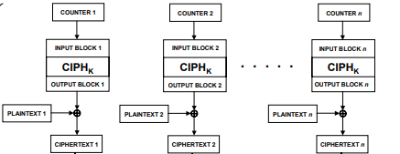
Figure 12 Counter (CTR)
Dworkin, M. (2001). Recommendation for Block Cipher Modes of Operation: Methods and Techniques. United States Department of Commerce, National Institute of Standards and Technology. https://nvlpubs.nist.gov/nistpubs/Legacy/SP/nistspecialpublication800-38a.pdf

Slide 19
The Solution?

Slide 20
CryptoStat
Directly tests the mapping of a block cipher
Does not use modes of operation
Uses Bayesian thinking to combine the results of many different tests
(Kaminsky, 2019)
Figure 4 Example CryptoStat Test Results

Slide 21
Methods

Slide 22
Previous Ideas (and their impact)
Comparing levels of randomness (e.g. pseudorandom, true random)
randomness
Accuracy of human perception of randomness
need large amount of data
Randomness of human generated random sequences
randomness test suites
generating random sequences
Strength of different encryption algorithms
block ciphers

Slide 23
Experimental Design
Essentially 3 different experiments (1 for each test suite)
Independent Variable: Mode of Operation
Dependent Variable: # of tests passed / randomness margin
Groups: ECB, CBC, OFB, CTR

Slide 24
Background
Operating System: Ubuntu 20.04 LTS (Dual boot with Windows 10) Graphics Card: NVIDIA GeForce GTX 1660 SUPER
Permissions - sudo chmod 755 /path/to/file
Keywords:
Code - Courier New Font
Instructions - Lora Font
/path/to/
Execute - open terminal at this location and enter the command
Edit - open the file in a text editor and make the changes specified

Slide 25
Ciphertext
Create plaintext
Execute dd bs=4000000 count=8000 if=/dev/zero of=/path/to/plaintext
Encrypt
Execute sudo apt install openssl
Execute openssl enc -aes-256-MODE -pbkdf2 -nosalt -K 8d19c708c2fa60012c558d98454a2018e5c7bb0e62d05ff60972f10750279323 -iv 00000000000000000000000000000000 -in /path/to/plaintext -out /path/to/ciphertextMODE
repeat and change MODE for each

Slide 26
NIST Statistical Test Suite - Installation
Download and extract the file from (National Institute of Standards and Technology, 2016b)
Execute make

Slide 27
NIST Statistical Test Suite - Usage
Execute ./assess 100000
Generator Options: 0
Prescribed Input File: /path/to/ciphertext
Statistical Tests: 1
Parameter Adjustments: 0
How many bit streams should be generated? 100
Input File Format: 1
Results appear in /path/to/sts-2.1.2/experiments/AlgorithmTesting/finalAnalysisReport.txt
Repeat for each mode of operation

Slide 28
Dieharder
Installation:
Execute sudo apt install dieharder
Usage:
Execute dieharder -a -g 201 -f /path/to/ciphertext
Repeat for each mode of operation

Slide 29
CryptoStat - Installation Pt. 1
Install prerequisites
Execute sudo apt install default-jdk
Execute sudo apt install nvidia-cuda-toolkit-gcc
Download and extract source distribution of Parallel Java 2 Library (PJ2) from (Kaminsky, 2019b)
Download and extract source distribution of CryptoStat from (Kaminsky, 2019a)

Slide 30
CryptoStat - Installation Pt. 2
Execute sudo update-alternatives --install /usr/bin/gcc gcc /usr/bin/gcc-8 80 --slave /usr/bin/g++ g++ /usr/bin/g++-8 --slave /usr/bin/gcov gcov /usr/bin/gcov-8
Execute every time you reopen the terminal:
export CLASSPATH=/path/to/CryptoStat/lib:/path/to/pj2/lib
export LD_LIBRARY_PATH=/path/to/pj2/lib/
export GCCBINDIR=/usr/bin/
export CRST_HOME=/path/to/CryptoStat

Slide 31
CryptoStat - PJ2 installation Pt. 1
Edit & Execute /path/to/pj2/lib/ccompile
Replace with gcc -I/usr/lib/jvm/default-java/include -I/usr/lib/jvm/default-java/include/linux -I/usr/lib/cuda/include -I/opt/cuda/include -I/usr/local/dcs/jdk/include -I/usr/local/dcs/jdk/include/linux -I/usr/local/cuda/include -shared -fPIC -o libEduRitGpuCuda.so edu_rit_gpu_Cuda.c -lcuda
creates edu_rit_gpu_Cuda.c and libEduRitGpuCuda.so

Slide 32
CryptoStat - PJ2 GPU capability installation Pt. 2
Edit & Execute /path/to/pj2/lib/edu/rit/gpu/example/ccompile
compute_20 → compute_(https://developer.nvidia.com/cuda-gpus)
Execute /path/to/pj2/lib/edu/rit/gpu/test/ccompile

Slide 33
CryptoStat - Recompile
Edit /path/to/CryptoStat/ccompile
compute_20 → compute_(https://developer.nvidia.com/cuda-gpus)
Edit /path/to/CryptoStat/jcompile
SOURCE_HOME=/path/to/CryptoStat/lib
PJ2_HOME=/path/to/pj2/lib
JDK_HOME=/lib/jvm/default-java
Execute /path/to/CryptoStat/compile

Slide 34
CryptoStat - Usage
Execute java pj2 Analyze -v "edu.rit.aes.AES256()" "edu.rit.crst.Single(00000000000000000000000000000000)" "edu.rit.crst.Rand(100,123456789)" "edu.rit.crst.Direct()" "edu.rit.crst.Adjacent(8)"

Slide 35
Results

Slide 36
Table 1 NIST Statistical Suite
Mode of Operation | Passed | Failed
ECB | 1 | 187
CBC | 187 | 1
OFB | 187 | 1
CTR | 185 | 3

Slide 37
Table 2 DieHarder
Mode of Operation | Passed | Weak | Failed
ECB | 0 | 0 | 114
CBC | 111 | 3 | 0
OFB | 110 | 4 | 0
CTR | 114 | 0 | 0

Slide 38
CryptoStat
Nonrandom rounds: 0/14
Randomness margin: 1.00000

Slide 39
Discussion

Slide 40
Analysis of Findings
Results were as expected
The differences between the results for each mode of operation, especially ECB, demonstrate that modes of operation affect the randomness of the ciphertext
CryptoStat successfully circumvented the issues plaguing the two more popular test suites assuming that is equally or more accurate

Slide 41
Limitations
Limited testing
Did not test Cipher Feedback mode
Only tested AES-256 → results cannot be generalized
Different inputs
CryptoStat did not allow the usage of only one key
Ignored Dieharder warning about file input
Different outputs
Difficult to compare results
No unit of accuracy or randomness for encryption algorithms

Slide 42
The Future
Future studies on the randomness of block ciphers should consider using CryptoStat instead of or in addition to the more popular NIST Statistical Test Suite and Dieharder test suite.
Verified creator’s and others’ concerns about NIST and Dieharder testing randomness from mode of operation in addition to randomness from the encryption algorithm.
Should test algorithms other than AES in order to measure consistency between CryptoStat and other test suites.

Slide 43
References

Slide 44
Ahmad, T., & Younis, U. (2014). Randomness testing of non-cryptographic hash functions for real-time hash table based storage and look-up of URLs. Journal of Network and Computer Applications. 41, 197-205. doi.org/10.1016/j.jnca.2013.11.007
Brown, R. G. (2021). Dieharder: A Random Number Test Suite. Duke University Physics Department. webhome.phy.duke.edu/~rgb/General/dieharder.php
Dworkin, M. (2001). Recommendation for Block Cipher Modes of Operation: Methods and Techniques. United States Department of Commerce, National Institute of Standards and Technology. nvlpubs.nist.gov/nistpubs/Legacy/SP/nistspecialpublication800-38a.pdf
Gevorkyan, M.N., Demidova, A.V., Korol’kova, A.V. & Kulyabov, D.V. (2020). A Practical Approach to Testing Random Number Generators in Computer Algebra Systems. Comput. Math. and Math. Phys. 60, 65–73. doi.org/10.1134/S096554252001008X

Slide 45
Kaminsky, A. (2019a). CryptoStat: Bayesian Statistical Analysis of Cryptographic Functions. Rochester Institute of Technology. cs.rit.edu/~ark/parallelcrypto/cryptostat/
Kaminsky, A. (2019b). Parallel Java 2 Library. Rochester Institute of Technology. cs.rit.edu/~ark/pj2.shtml
Kaminsky, A. (2019c). Testing the randomness of cryptographic function mappings. Cryptology ePrint Archive. eprint.iacr.org/2019/078.pdf
National Institute of Standards and Technology. (2016a). AES Development - Cryptographic Standards and Guidelines. United States Department of Commerce. csrc.nist.gov/projects/cryptographic-standards-and-guidelines/archived-crypto-projects/aes-development
National Institute of Standards and Technology. (2016b). NIST SP 800-22: Download Documentation and Software. United States Department of Commerce. csrc.nist.gov/projects/random-bit-generation/documentation-and-software

Slide 46
Patil, P., Narayankar, P., Narayan, D.G., & Meena S.M. (2016). A Comprehensive Evaluation of Cryptographic Algorithms: DES, 3DES, AES, RSA and Blowfish. Procedia Computer Science, 78, 617-624. doi.org/10.1016/j.procs.2016.02.108
Rukhin, A. (2011). Statistical Testing of Randomness: New and Old Procedures appeared as Chapter 3 in Randomness through Computation, H. Zenil ed. World Scientific, 2011, 33-51. doi.org/10.1142/9789814327756_0003
Rukhin, A., Soto, J., Nechvatal, J., Smid, M., Barker, E., Leigh, S., Levenson, M., Vangel, M., Banks, D., Heckert, A., Dray, J., & Vo, S. (2010). A Statistical Test Suite for Random and Pseudorandom Number Generators for Cryptographic Applications. United States Department of Commerce, National Institute of Standards and Technology. tsapps.nist.gov/publication/get_pdf.cfm?pub_id=906762
Soto, J. (1999). Randomness Testing of the Advanced Encryption Standard Candidate Algorithms (NISTIR 6390). United States Department of Commerce, National Institute of Standards and Technology. tsapps.nist.gov/publication/get_pdf.cfm?pub_id=151193

